Slide 1
Mood Detect
Chih Wei Tung, Zhonghao Guo, Weixuan Jiang, Shanshan Zhao
https://github.com/tungchihwei/EC601-Mood-Detect
https://trello.com/b/QZmTZ7UV/ec-601-final-project

Slide 2
Product Statement
Mood detect is an android app that can detect human mood just by recording human voice.
This product is for psychiatrists and their patients.

Slide 3
Targeted users
Psychiatrists
Patients

Slide 4
User Stories
For psychiatrist
Want to know if their patients are doing well during the days that they’re not meeting
Want to trace their patients’ condition even when they are not in a same room
Want to get a notice immediately whenever this app record a depressed voice from patients
Need some data to help them make a directed plan of treatment for each patients
For Patients
Want someone to comfort their mood
Want someone to notice their bad mood

Slide 5
Minimum Valuable Product
Detect mood from patients’ voice
Send notice to psychiatrists whenever a patient is not in a good mood

Slide 6
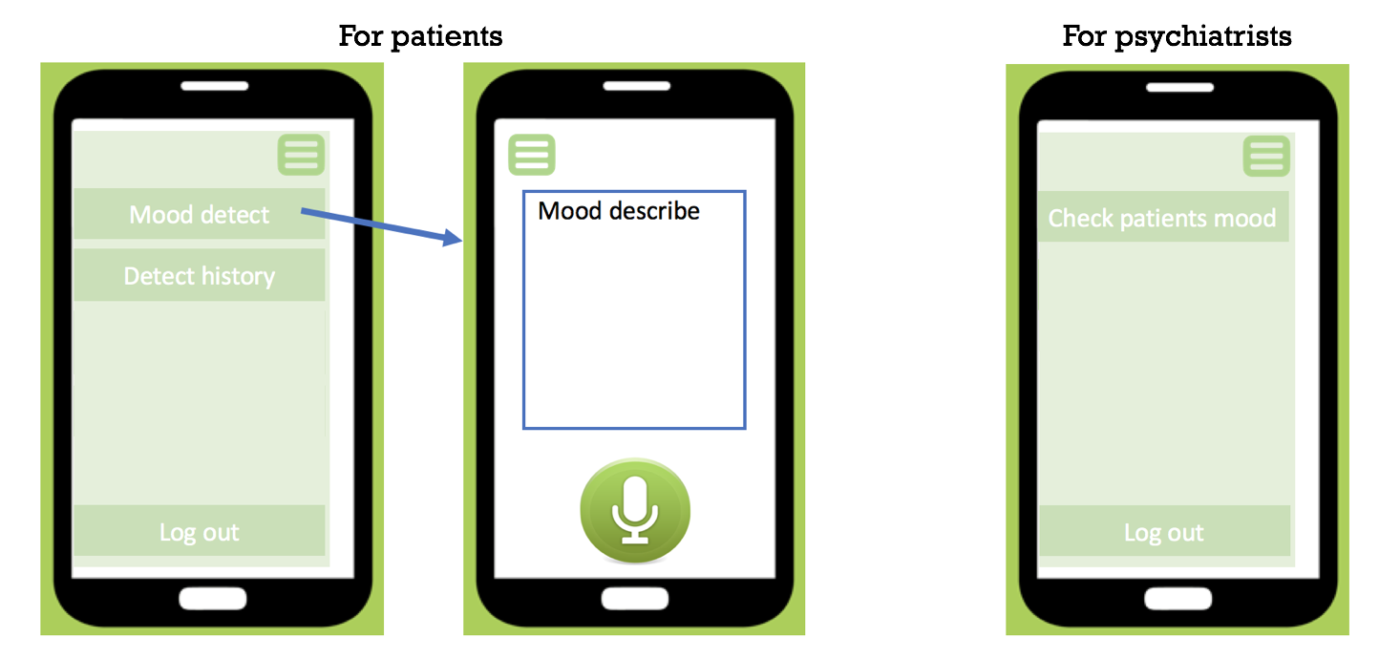
Android app prototype

Slide 7
Research background
Detection and Analysis of Emotion From Speech Signals
Assel Davletcharovaa, Sherin Sugathanb, Bibia Abrahamc, Alex Pappachen Jamesa,b
Emotion Detection from Speech
https://goo.gl/GktLoq

Slide 8
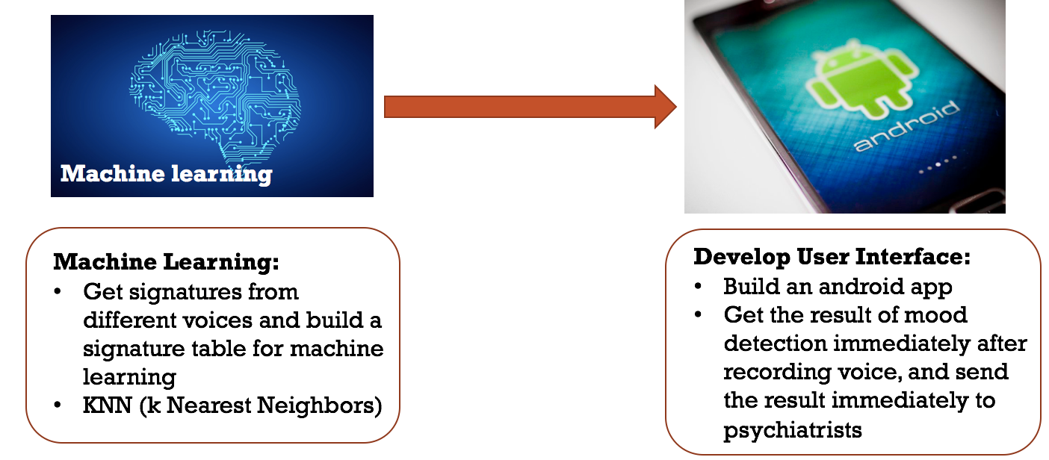
Modular Diagram
Notes:
可以较好地避免样本数量的不平衡问题
可以最大程度地减少分类过程中的误差 项。对于一些类别特征不明显的类别而言，KNN法更能体现出其分类规则独立性 的优势，使得分类自学习的实现成为可能。

Slide 9
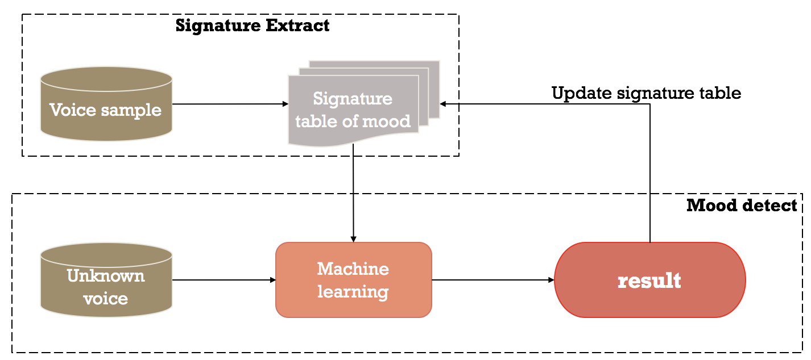
Workflow diagram

Slide 10
Next Sprint Board
Start working on android app UI design
Start extracting signatures for machine learning
Do some more researches on others’ researches that are related to mood detect

Slide 11
Team and Sprint 1 Responsibilities
Chih Wei Tung: Android app develop learning, research on related papers, make PPT and sprint 1
Zhonghao Guo: Android app develop learning, research on related techniques
Weixuan Jiang: Android app develop learning, research on related projects
Shanshan Zhao: Android app develop learning, research on similar apps

Slide 12
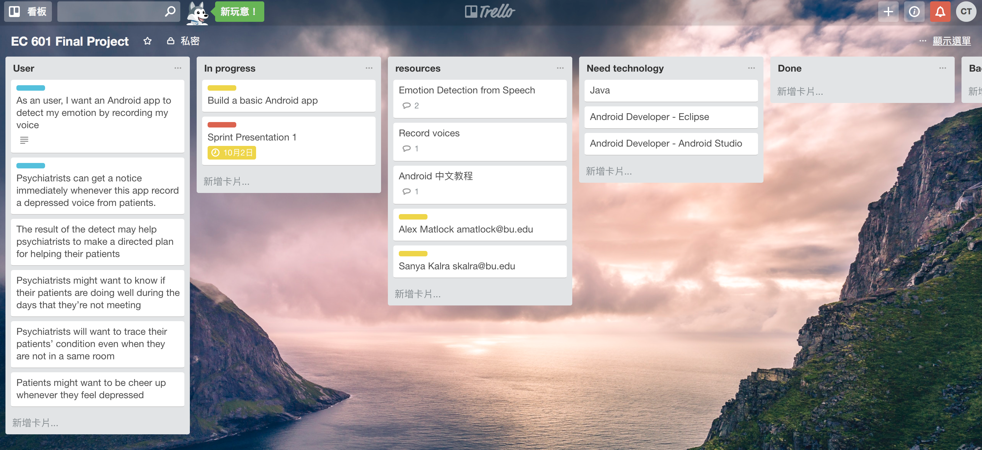
trello

Slide 13
Thank You

